Slide 1

Synaptix Digital Solution
Project Pioneer
9th November 2024

Slide 2
The Pioneers
Susan Gbemile Amuche Delilies Temitope Ajayi Samuel Ogunrinde Timothy Afube Aminat Adigun Odion Oifoh Aderayo Tinuoye Tolulope Ayodele Adedoyin Akinmoyo
Funke Fadumo Angele Ntsa Chukwuka Oforgu Afees Sodiq Temitayo Oyedele Itibi Otoju Ifeoma Menanya Azibugha Clinton Oluwayinka Ajosanmi Iloanusi Chibueze
Yusuf Dare Rosebella Darko Olumuyiwa Igbalaye Esther Molehin Eyituoyo Afini Kelvin Onyemabi Pallavi Shende Ademola Augustina Temitope Deyeye

Slide 3

Introduction
At Project Pioneer, we conducted an index analysis of user engagement for Synaptix Digital Solutions, using tools like SQL, PowerBI, and Excel to provide data-driven insights that support organic business growth to boost turnover in the coming quarter.
Synaptix Digital Solutions specializes in innovative digital solutions, from streamlined automation to advanced analytics, designed to empower businesses as they navigate the digital landscape and enhance their strategic decision-making for sustainable success.

Slide 4
Aim
Objectives
Extract, clean, and preprocess user engagement data to ensure accuracy and consistency.
Conduct an in-depth analysis of user engagement metrics to identify key patterns and trends impacting user retention and app usage.
Develop data visualizations to illustrate engagement insights and support data-driven decision-making.
Provide strategic recommendations based on analysis to enhance user retention and increase app engagement.
To perform an in-depth analysis of user engagement data to identify patterns and trends that can help improve user retention and app usage.

Slide 5

Proposed Solution
Data Pre-processing: Integrate and clean user engagement data, define key metrics, and segment users for targeted insights.
Analysis: Use of descriptive and user segmentation analysis to understand the overall profile of users and tailor strategies to each group.
Visualization: Create dashboards and reports to highlight feature usage, and engagement patterns.

Slide 6
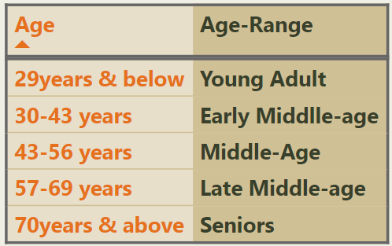
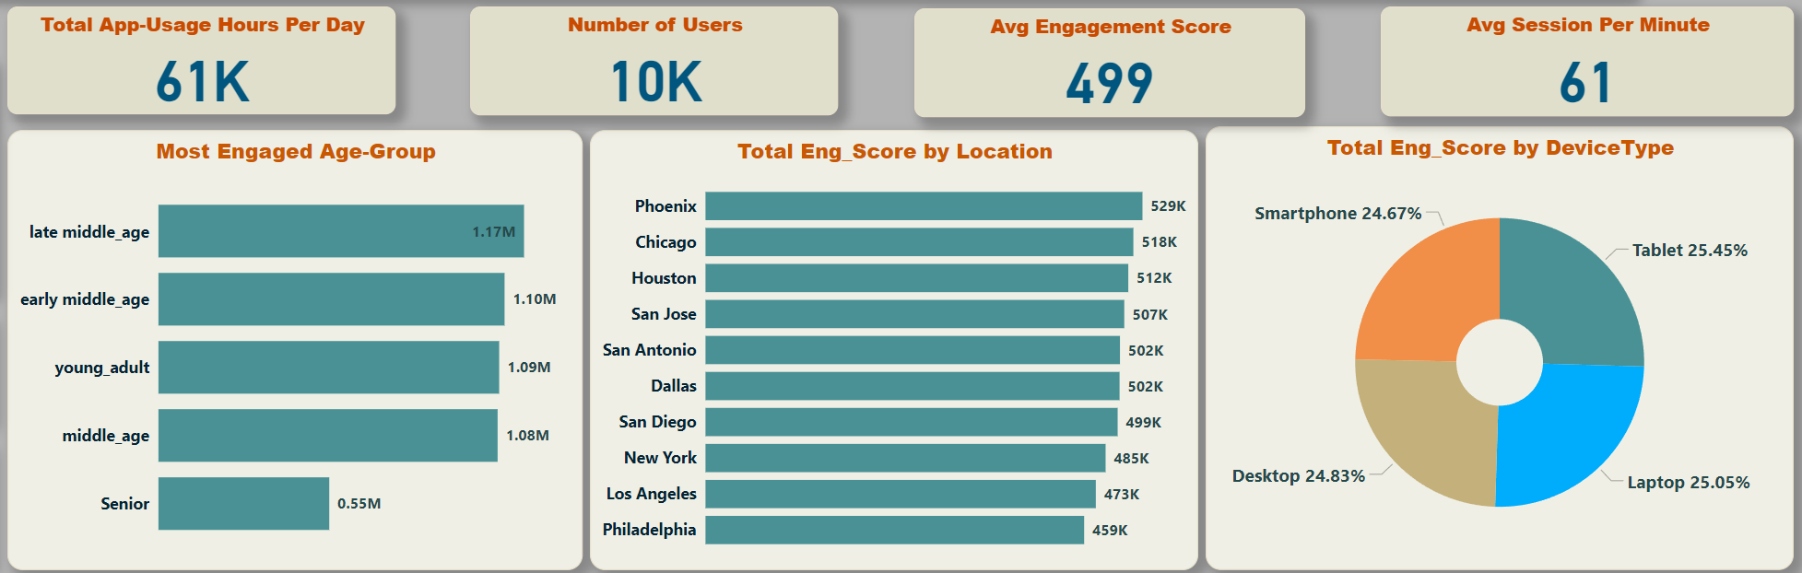
Engagement Score By User Segment
At 1.17M, late middle-aged users have the highest Engagement Score and are 114% higher than Seniors, who have the lowest Engagement Score at 545K.
Phoenix leads with the highest engagement score at 529K, followed by Chicago at 518K, while Philadelphia has the lowest engagement score at 459K.
Engagement by device type is relatively balanced, with Tablet being the most popular at 25.45%

Slide 7
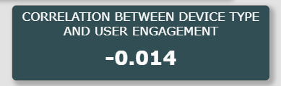
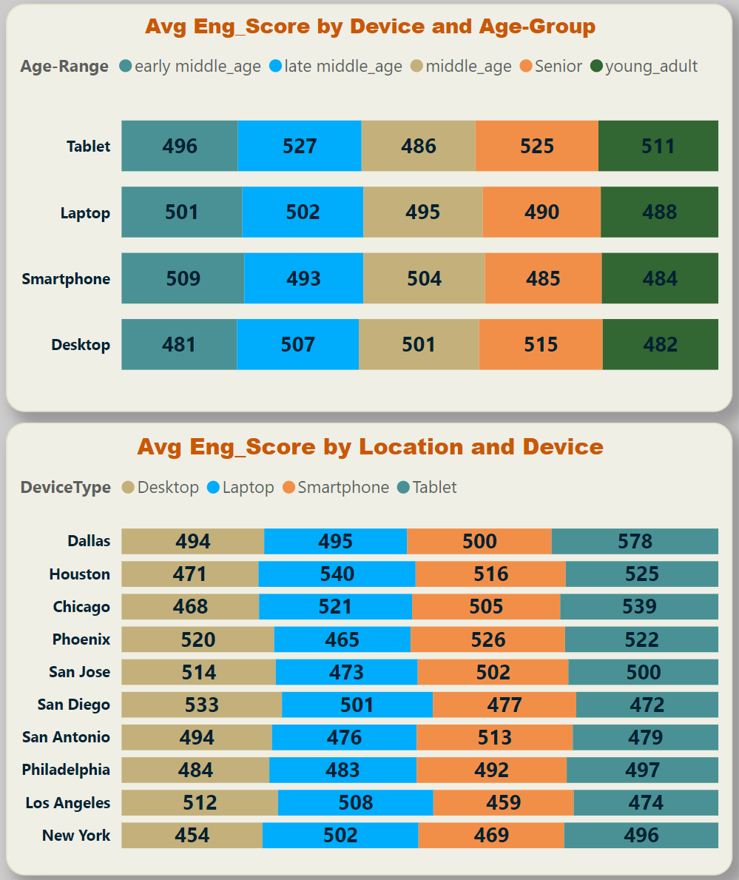
Common Characteristics
Tablet is the most used device on average, primarily by late middle-aged and senior users at 527 & 525 respectively.
Dallas has the highest engagement score on average with Tablet as the top device at 578, while New York is the least engaged city.
A correlation coefficient of -0.014 was found which suggests that there is a very weak negative relationship existing between device type and user engagement.

Slide 8
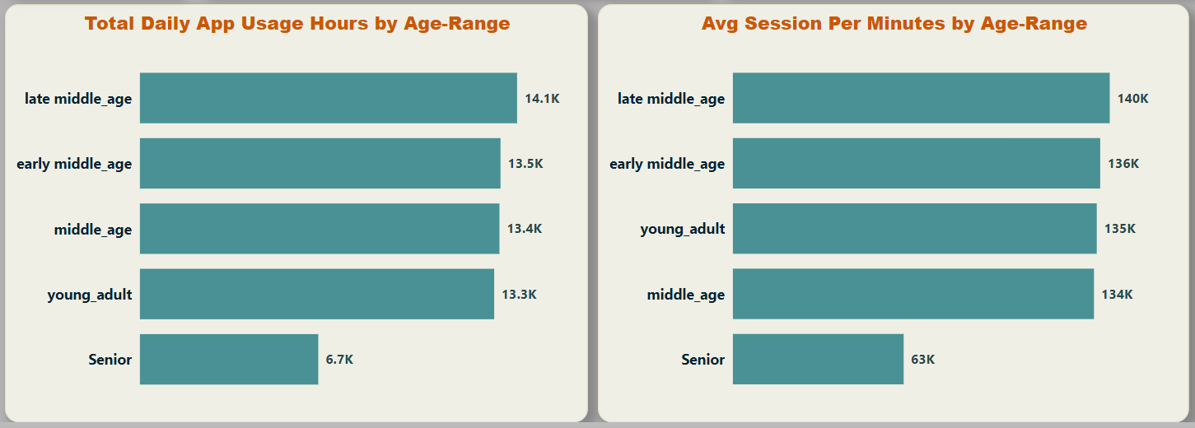
Users at Risk of Churning
The users with the least daily app usage hours and session per minutes are the Seniors.
At 6.7k daily hours and 63k average session per minutes, the Seniors are the most at risk of leaving.

Slide 9
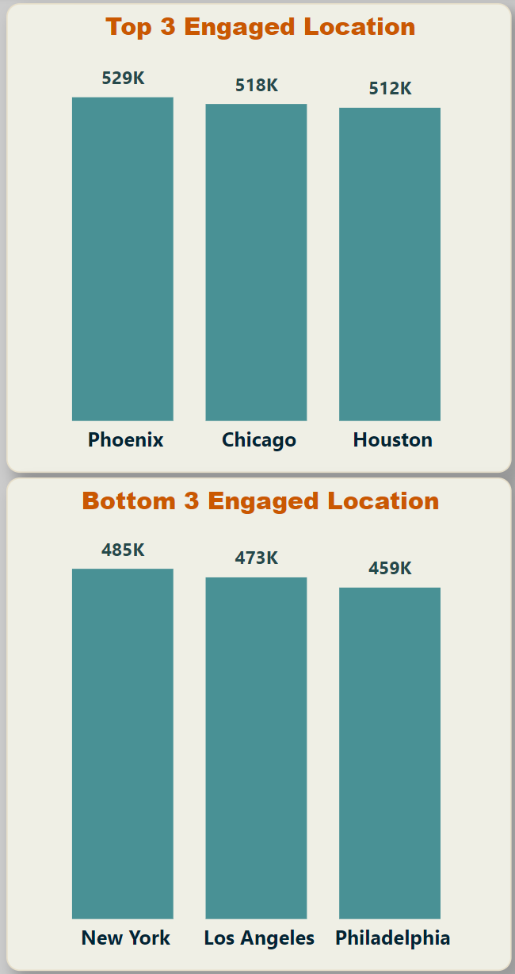
Locations with Highest and Lowest Engagement
The locations with the highest engagements are Phoenix, Chicago and Houston with over 500,000 each, while New York, Los Angeles and Philadelphia have the lowest with over 400,000 each.
Philadelphia, which is the lowest-performing city at 459K engagement score, could benefit from a boost in awareness through culturally relevant advertising approaches.

Slide 10

Localized Content and Marketing: Tailor content and advertising to reflect local cultures, languages, and interests.
Recommendation
Location-Specific Features: Offer features that are particularly relevant or useful to certain areas.
Localized Push Notifications: Create regionally tailored notifications that align with local events, trends, or seasons.
To reduce churn among seniors, Synaptix Digital can create a senior-friendly interface with audio navigation and community support features to enhance usability and foster connection.

Slide 11

Conclusion
From our analysis, we have been able to identify valuable insights into the user engagement patterns within the app, offering a clear path to enhance retention and usage.
These findings show that users with high engagement share specific traits, like device preference and consistent session durations, suggesting opportunities for personalized engagement strategies.

Slide 12

Thank you for your time

